Slide 1

Hoops For Humanity Club 2014-2015

Slide 2
Mission Statement
Hoops For Humanity will help the community and its organizations while having fun and playing basketball
This year we will be donating funds to the Golden State Warriors Community Foundation

Slide 3

Basketball
Once a month, or more often, we will play basketball in the small or large gym during lunch!

Slide 4

How will we help the community?
Hoops For Humanity Skills Challenges
3 on 3 Tournaments
Golden State Warrior Games

Slide 5
Golden State Warriors Community Foundation Fundraiser
We will hosting multiple fundraising events this year. Some of these events include 3 on 3 Basketball Tournaments, and Skills Challenges. Throughout the year, we will also be looking for more ways to raise funds
Here are some pictures from the 3 on 3 Tournament last year.

Slide 6
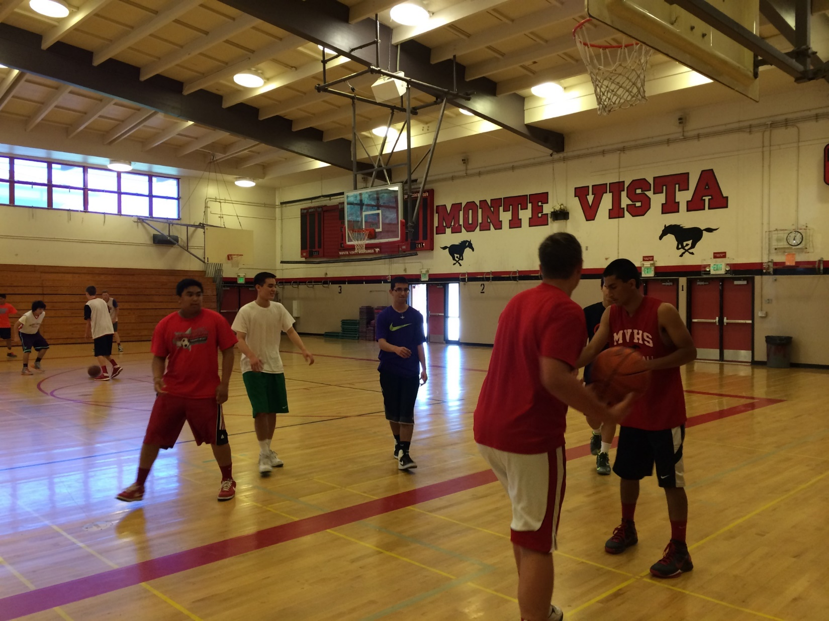

Slide 7
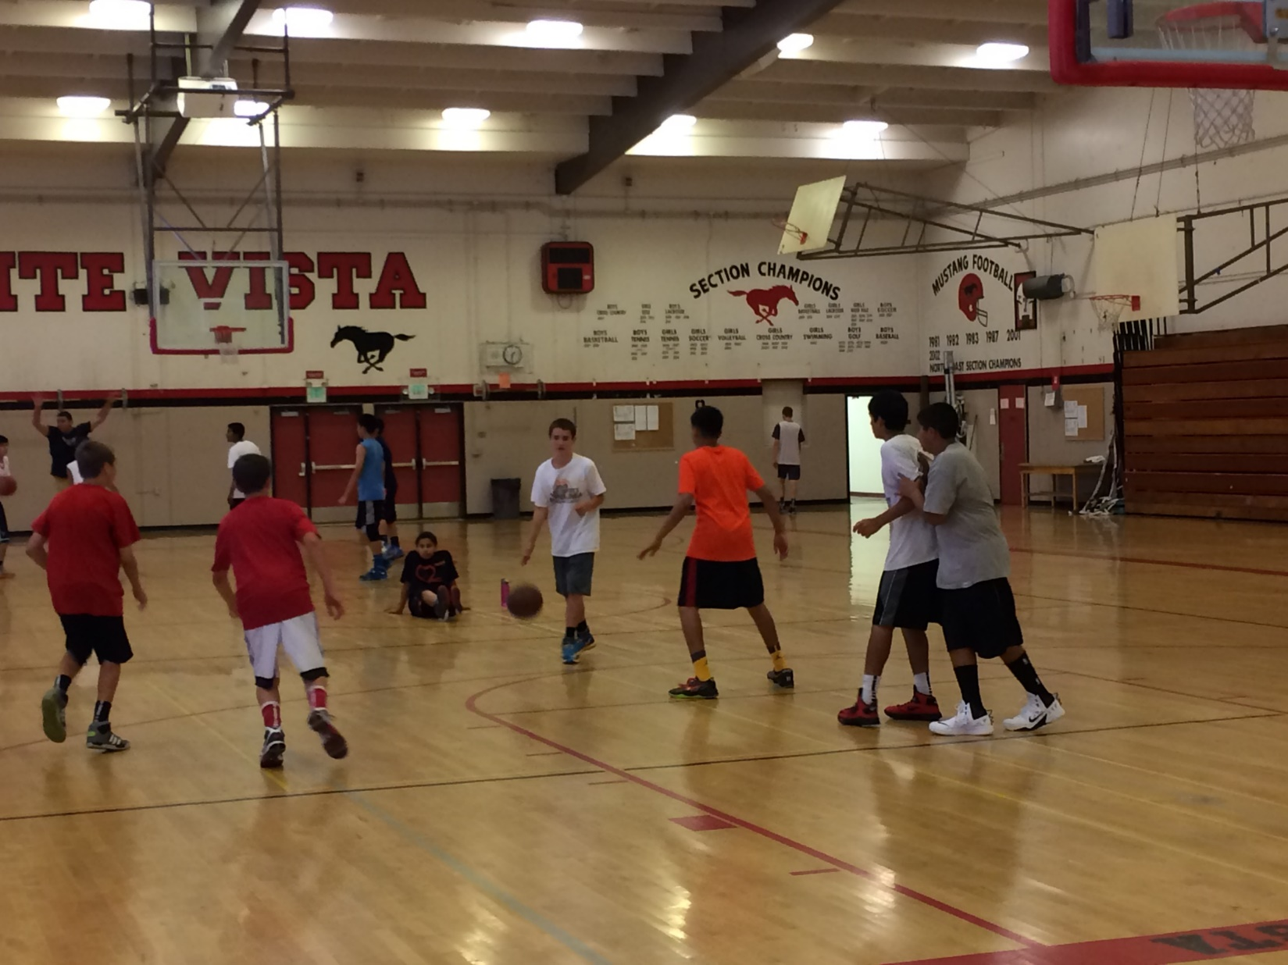

Slide 8
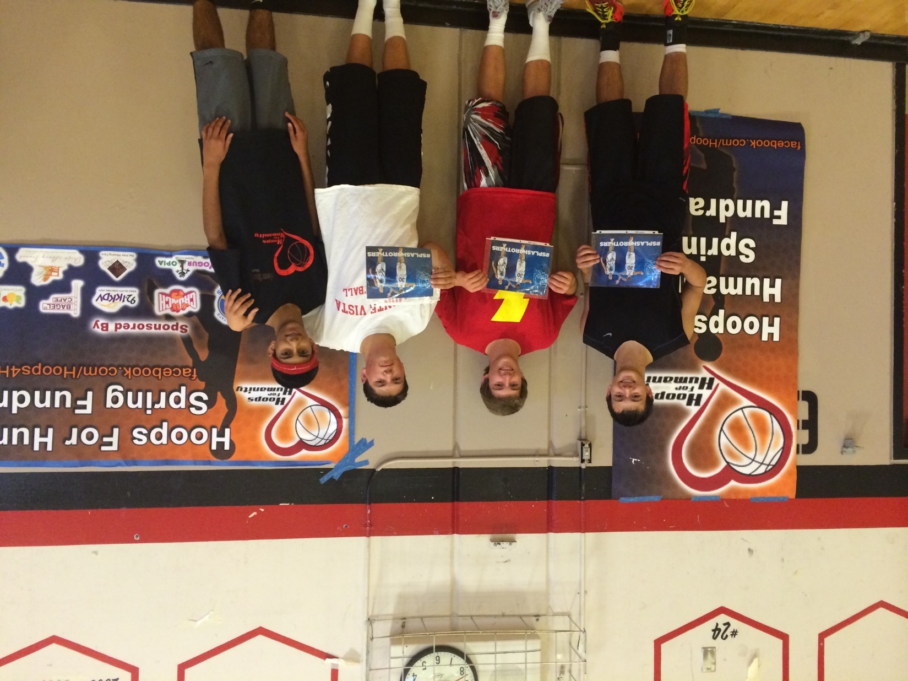

Slide 9
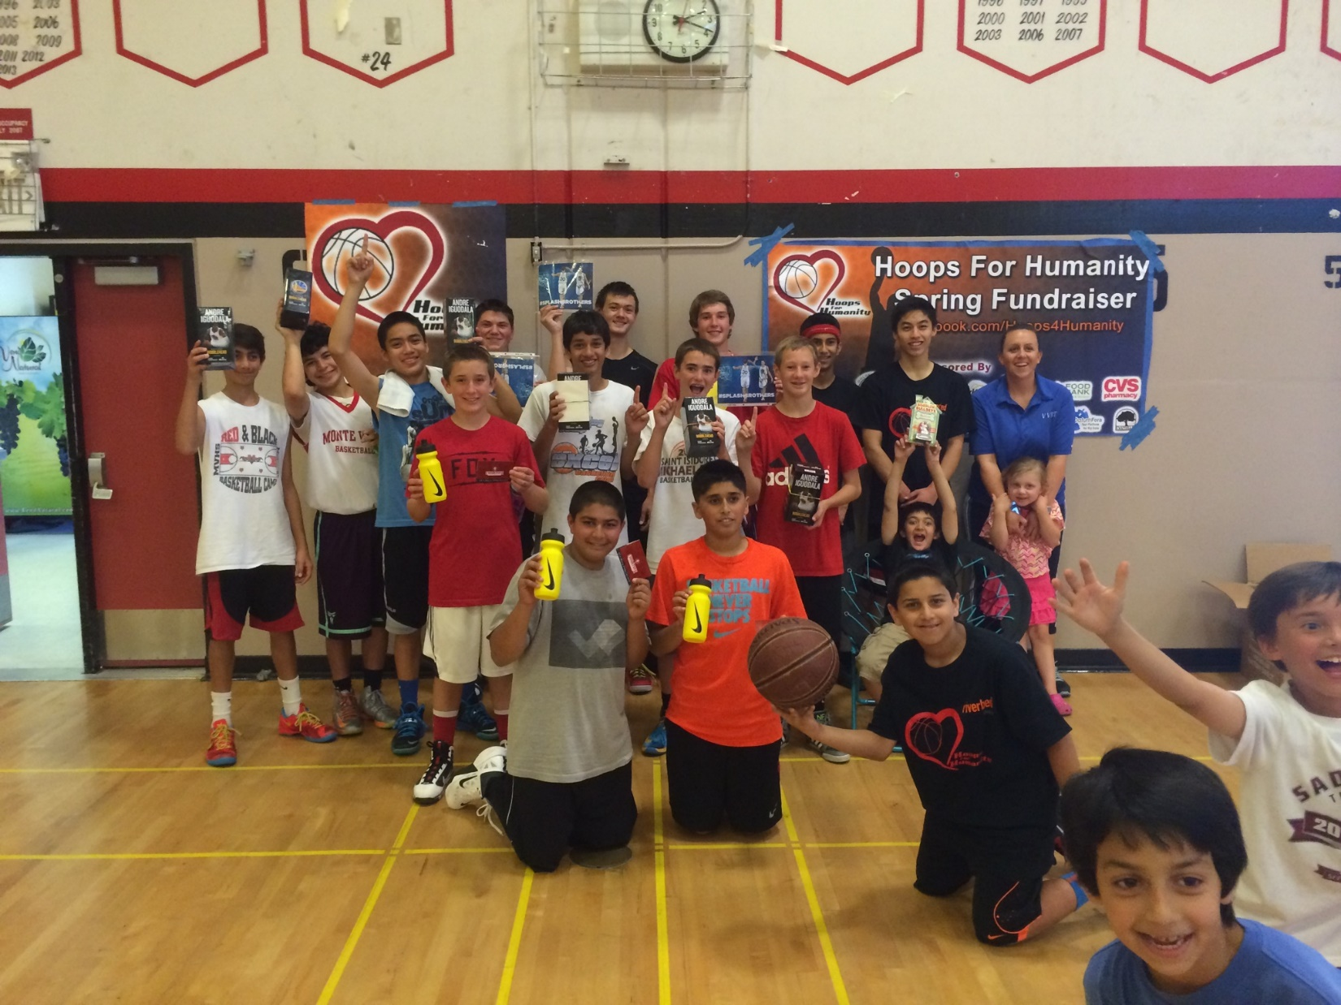

Slide 10
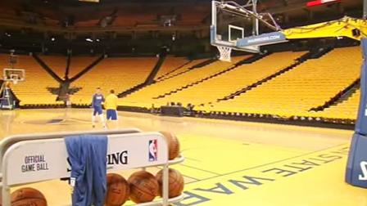
What will we get out of this?
-Opportunities to volunteer for these organizations
-Leadership Opportunities
- Tours of Oracle Arena and/or the Warriors Practice Facility
Go to a Warriors Game, and watch the players warm up courtside
Here are some pictures of last years Warriors game
Be Part of the
Golden State
Warriors
Organization

Slide 11
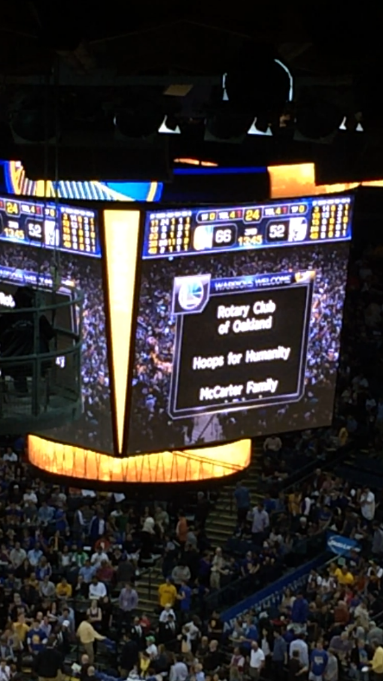

Slide 12
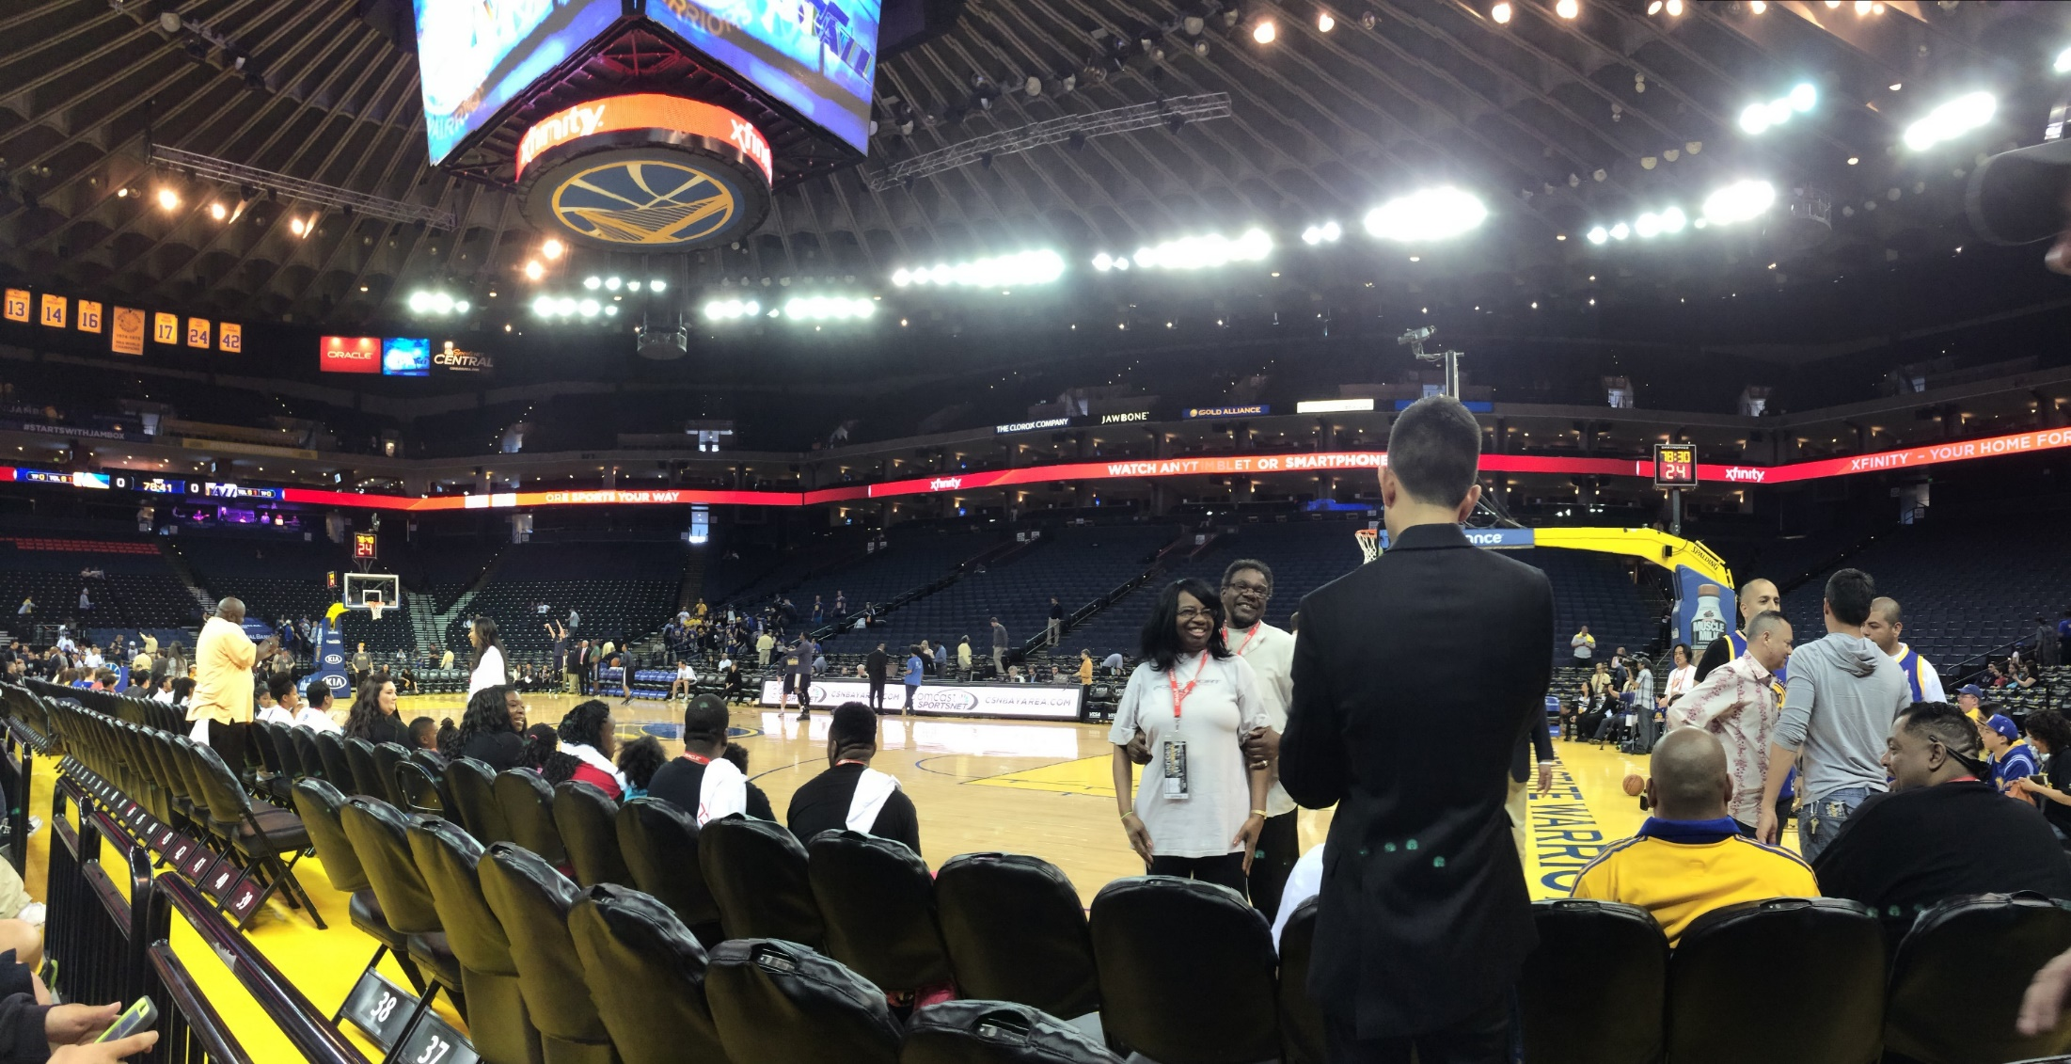

Slide 13
